Slide 1


LOST IN "वसुधा"
Pixelverse MindSpark
KRAFTON INDIA
By : Error By Night

Slide 2

TEAM MEMBERS
JANHVI
KATAKDHOND
RUSHABH
RATNAPARKHI
RUDRAKSHI
SAWANT
VARAD
VAIDYA
ERROR BY NIGHT

Slide 3

A young South Indian boy embarks on a journey across India in search of the Taj Mahal. Along the way, he explores the Charminar, Golden Temple, Ram Mandir, Shivneri Fort, Goa’s beaches, Howrah Bridge, Tirupati Temple, and Rajasthan’s desert. Through his travels, he gets lost in his vasudha,he discovers that India, his homeland, is his true treasure.
Lost in
"वसुधा"

Slide 4


ENGINE USED
Godot Engine is a free, open-source game engine for creating 2D and 3D games. It features a node-based architecture, making it easy to build and organize complex projects. Godot supports GDScript, C#, and VisualScript for scripting, with export options to multiple platforms like Android, iOS, and HTML5. Lightweight and beginner-friendly, it offers built-in tools for animation, UI, and physics. With no licensing fees, it’s widely used by indie developers and professionals alike.

Slide 5

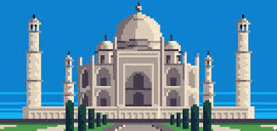
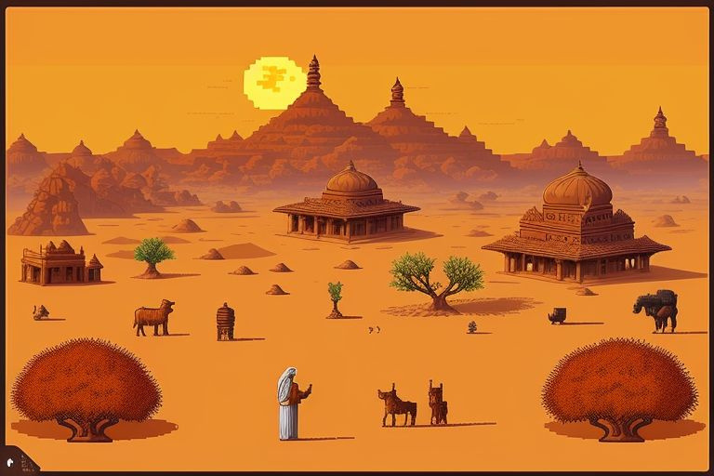
Background
TEMPLATES

Slide 6
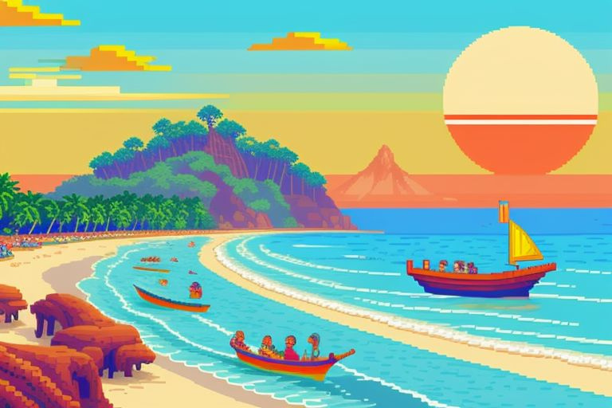
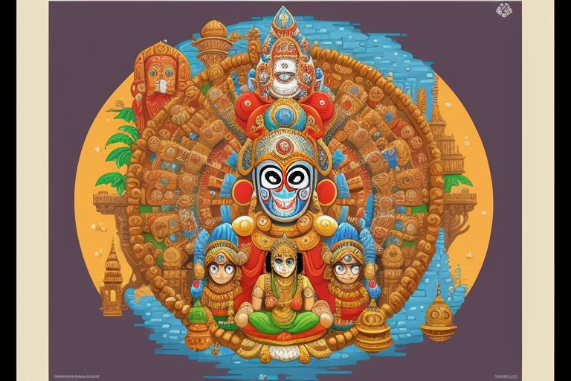
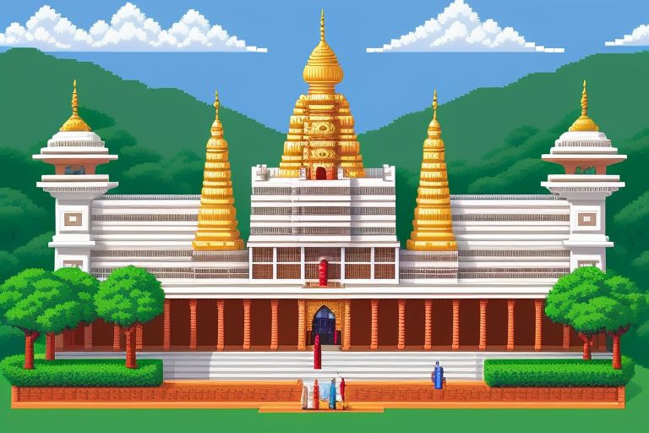
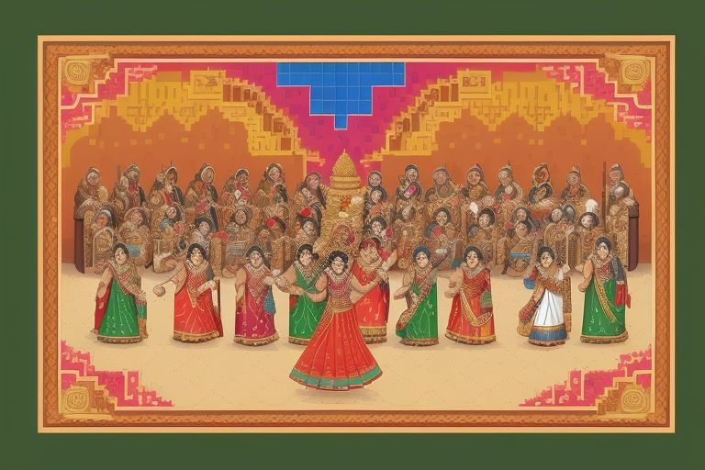
Background
TEMPLATES

Slide 7

Main character

Slide 8
How the game fits into the theme for the event:
WE HAVE DEVELOPED A GAME INSPIRED BY MARIO, CENTERED AROUND THE THEME OF INDIAN EXPLORATION. THE BACKGROUNDS FEATURE FAMOUS INDIAN LANDMARKS, SHOWCASING THE COUNTRY'S RICH DIVERSITY. OUR MAIN CHARACTER IS A QUINTESSENTIAL SOUTH INDIAN GUY DRESSED IN A LUNGI, EMBODYING THE SPIRIT OF ADVENTURE AS HE NAVIGATES THROUGH THIS VIBRANT WORLD.

Slide 9
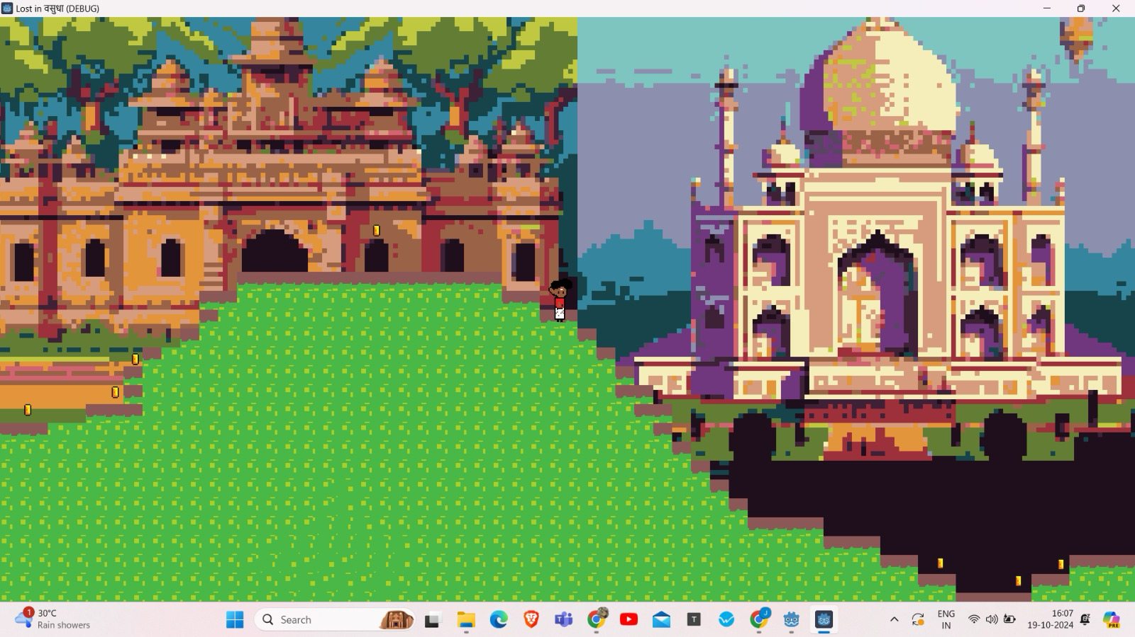
FINAL OUTPUT:

Slide 10
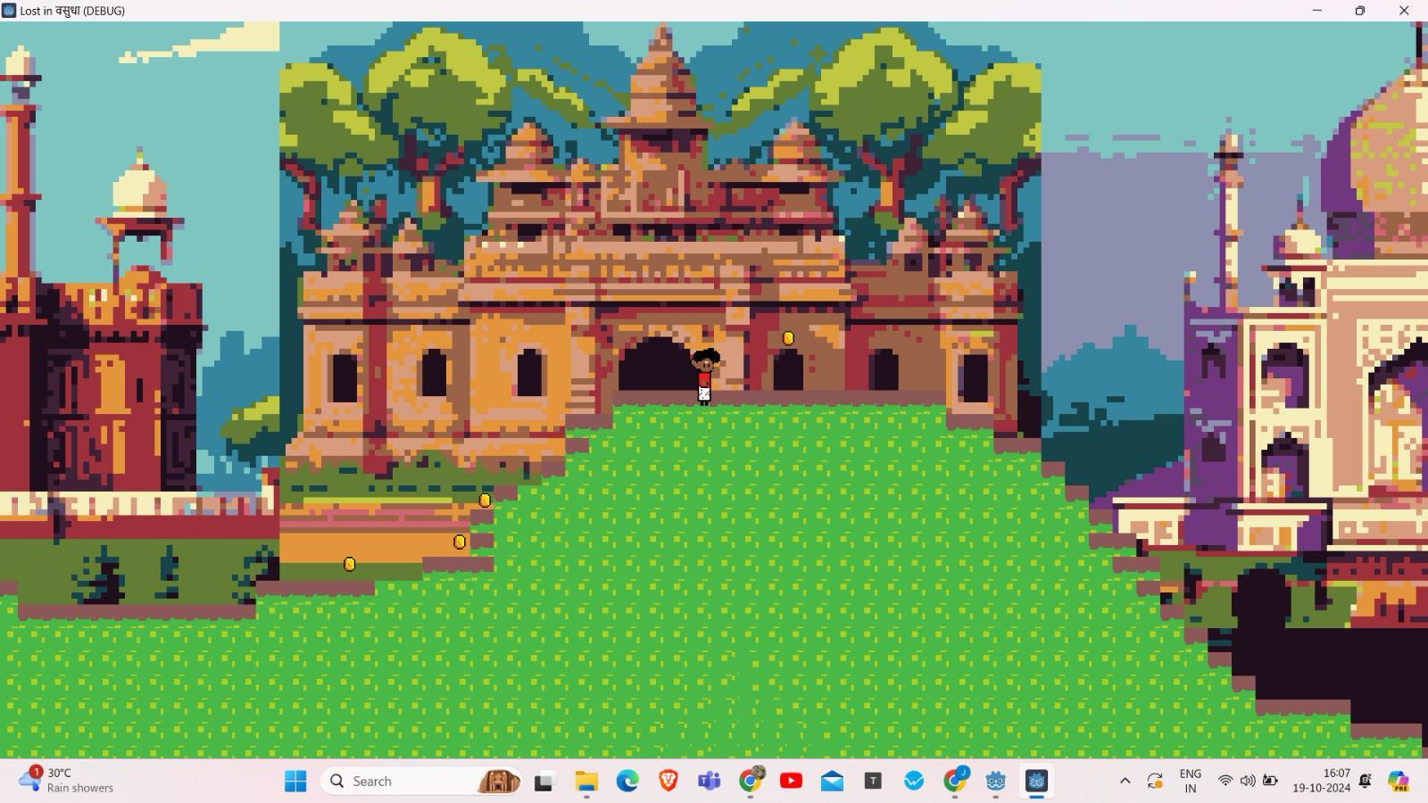

Slide 11
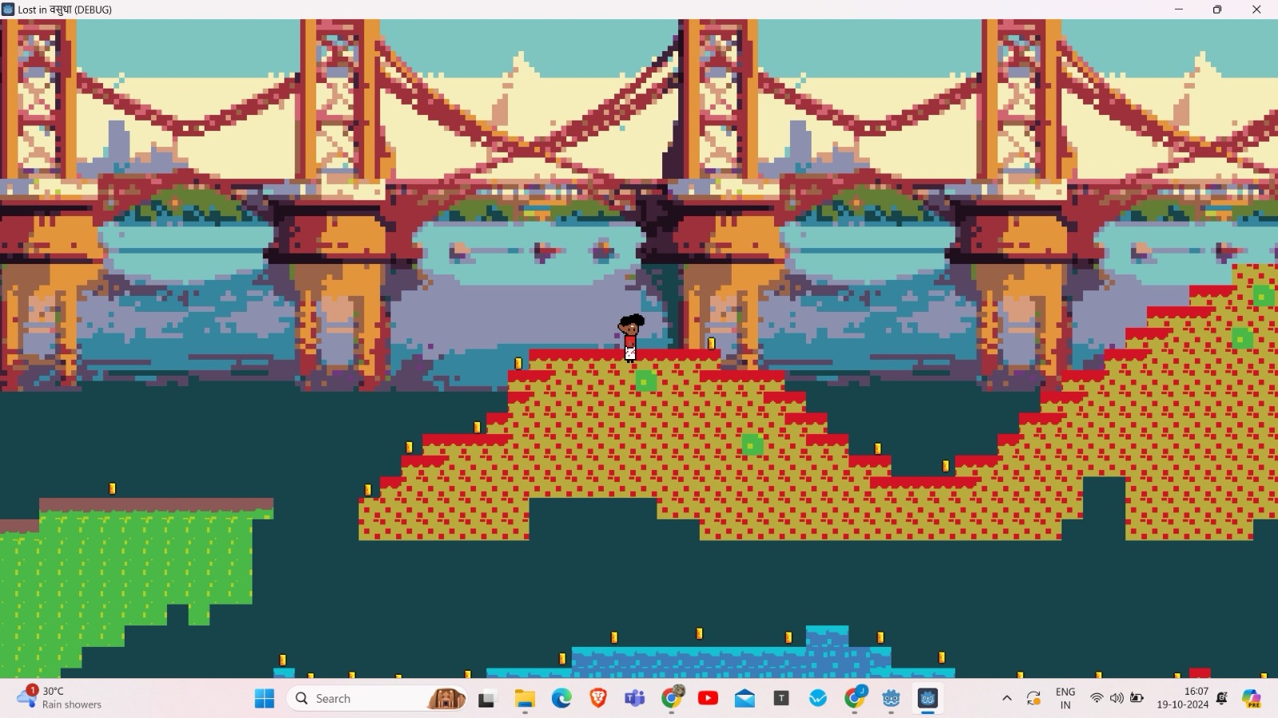

Slide 12
THANK YOU!

